Slide 1
Enzyme Immobilization : A technique for Industrial and Clinical applications
Presented by-
Mr. Shabir Hussain
Assistant Professor (Biochemistry)

Slide 2
Introduction
Immobilization of enzymes refers to the technique of confining / anchoring the enzymes in or on an inert support for their stability and functional reuse.
By employing this technique, enzymes are made more efficient and cost effective for their industrial use.
Immobilized enzymes retain their structural conformation necessary for catalysis.

Slide 3
Historical events
Invertase immobilized on activated charcoal (Nelson & Griffin, 1916).
Enzyme immobilization by covalent bonding on diazonium derivative(Grubhofer & Schleith,1953).
Encapsulation of enzymes in semi-permeable spherical membranes(Chang, et al.,1964).
Cross-linking of crystalline enzymes(Quiocho & Richards, 1964).

Slide 4
Aminoacylase immobilized on DEAE-sephadex used for production of L-aminoacid (Chibata, et al., 1967).
Immobilized penicillin G acylase for production 6-APA (intermediate in synthesis of semi-synthetic antibiotics) (Mosbach, 1976).
Immobilized glucose isomerase for production of fructose syrup (Messing & Filbert, 1975).

Slide 5
Obtained higher activity by chemical modification of enzymes(with PEG) (Takabaskal, 1984).
Increase in optimum temperature of epoxy hydrolase (35-45º C) using Triton X-100 (Ursini et al., 1999).
Development of cross-linked enzyme crystals (CLEC) suitable for both organic and aqueous media (Cao and Elzinga, 2003).

Slide 6
Purpose
Re-use of enzymes for many reaction cycles.
Ability of enzymes to provide pure products.
Lowering the total production cost of enzyme mediated reactions.
Minimize the enzymes lost in the product.
Providing the ability to control reaction times.
Easy separation from reaction mixture.

Slide 7
Material for Enzyme Immobilization
Organic
Natural polymers
Polysaccharides: Cellulose , Agar, Agarose , Alginate
Carbon: Activated charcoal
Synthetic Polymers
Polystyrene.
Other polymers: polyacrylate, polyacrylamide, polyamides
Inorganic
Natural minerals: bentonite,Silica, Alumina
Processed materials: glass

Slide 8
Properties of ideal carrier matrix
Inertness toward enzymes.
Physical strength (resistance to compression)
Enhancement of enzyme specificity.
Reduction in non-specific adsorption.
Resistance to microbial attack.
Reduction in product inhibition.
Availability at low cost.

Slide 9
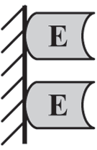
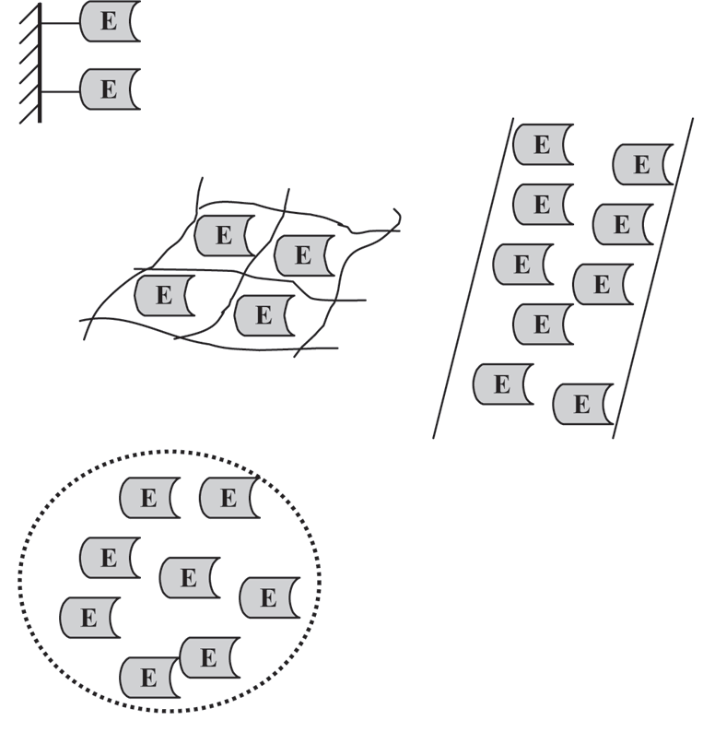
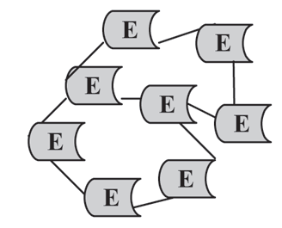
Methods for Enzyme Immobilization
Physical adsorption
Covalent bonding
Entrapment
Microencapsulation
Cross-linking

Slide 10
Physical adsorption
Physical binding of enzymes on the surface of an inert support.
Support materials may be inorganic (e.g. alumina, silica gel, calcium phosphate gel, glass) or organic (starch, carboxymethyl cellulose, DEAE-cellulose, DEAE - sephadex).
Adsorption occurs by weak forces such as Van der Waals and hydrogen bonds.
Adsorbed enzymes can be easily removed by minor changes in pH, ionic strength or temperature.
Example Invertase was adsorbed on activated charcoal.
(Nelson and Griffin, 1916)

Slide 11
Covalent bonding
Immobilization by creation of covalent bonds between the chemical groups of the enzymes and the support.
Technique is widely used, but is often associated with loss of some enzyme activity.
The inert support usually requires pre-treatment (to form pre-activated support) before it binds to enzyme.

Slide 12
Common methods of covalent bonding:
Cyanogen bromide activation
Diazotation
Peptide bond formation

Slide 13
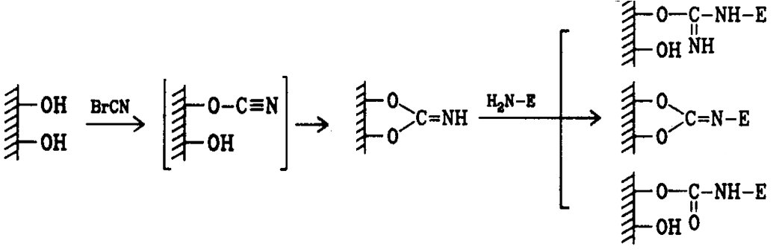
Cyanogen bromide activation
The inert support materials (cellulose, sepharose, sephadex) containing glycol groups are activated by CNBr, which then bind to enzymes and immobilize them.
polysaccharide imidocarbonate derivative immobilized enzyme
(Axen, et al., 1967)

Slide 14
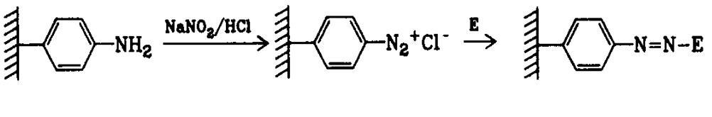
Diazotation
Some of the support materials (aminobenzyl cellulose, amino derivatives of polystyrene) are subjected to diazotation on treatment with NaNO₂ and HCl. They in turn, bind covalently to tyrosyl or histidyl groups of enzymes.
p- aminobenzyl cellulose
diazonium derivative immobilized enzyme
(Campbell, et al., 1951)

Slide 15

Peptide bond formation
Enzyme immobilization can also be achieved by the formation of peptide bonds between the amino (or carboxyl) groups of the support and the carboxyl (or amino) groups of enzymes.
CM- cellulose Carbodiimide Immobilized enzyme
(Brandenberger, 1957)

Slide 16
Entrapment
Entrapment inside a polymer or a gel matrix.
Size of the matrix pores to retain enzyme (substrate and product molecules pass through).
Enzyme is not subjected to strong binding forces and structural distortions.
Deactivation may occur due to changes in pH or temperature or addition of solvents.
Matrices include polyacrylamide gel, collagen gelatin, starch, cellulose, silicon.

Slide 17
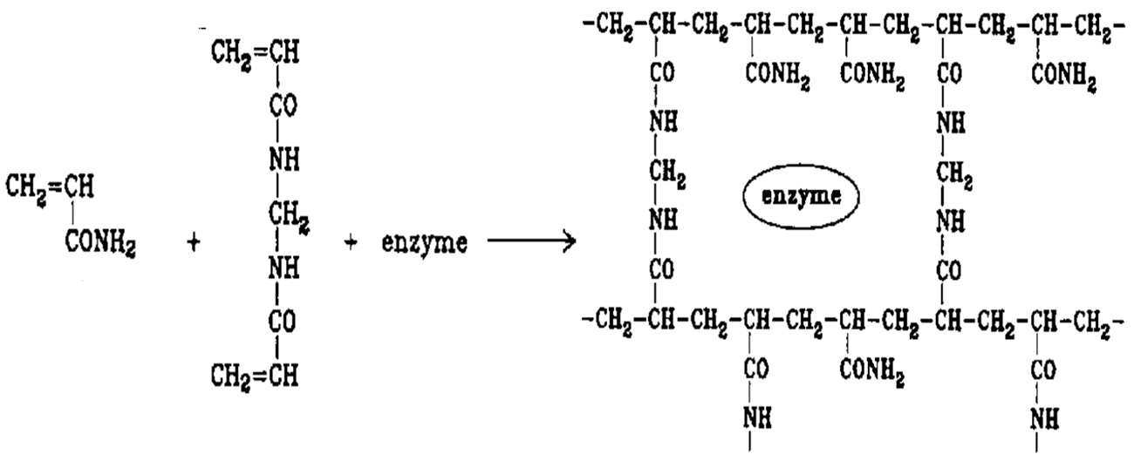
Enzyme inclusion in gels
Polyacrylamide gels:
*
**
acrylamide
bis acrylamide
polyacrylamide
*TEMED
**Ammonium per Sulfate
(Bernfeld and Wan, 1963)

Slide 18
Microencapsulation
A spherical particle formation process where in a liquid or suspension is enclosed in a semi permeable membrane.
The membrane may be polymeric, lipoidal, lipoprotein – based or non – ionic in nature.
Example : Nylon microcapsules formed by hydrophillic monomer(1,6-hexamethylene diamine), hydrophobic monomer(sebacoyl chloride) and organic solvent cyclohexane-chloroform mixture.
By formation of liposome.
(Chang, et al., 1964)

Slide 19
Cross-linking
Absence of solid support is a characteristic feature of immobilization of enzyme by cross-linking.
Enzymes are immobilized by creating cross-links between them, through the involvement of polyfunctional reagents.
Reagents reacts with the enzymes and create bridge which form the backbone to hold enzyme molecules.
Reagents used for cross-linking include glutaraldehyde, diazobenzidine, hexamethylene and diisocyanate.

Slide 20
͢
E.NH₂ CHO
⁺ (CH₂)₃
E.NH₂
E.N
ӀӀ
CH
Ӏ
Ӏ
(CH₂)₃
Ӏ
Ӏ
CH
CHO
ӀӀ
E.N
Glutaraldehyde
Immobilized enzymes
ENZYMES IMMOBILIZED BY CROSS-LINKING
(Quiocho and Richards, 1964)

Slide 21
Advantages of Enzyme Immobilization
Can be used repeatedly.
Products are enzyme – free.
Easy to separate enzyme and products.
Increase in thermo-stability of enzyme.
Easy handling of enzymatic reaction.
Allows catalysis in unfavourable media.

Slide 22
Disadvantages of Enzyme Immobilization
Possibility of loss of biological activity of an enzyme.
Immobilization means additional cost, require sophisticated equipments.
Immobilization may alter shape of enzyme.
Enzyme may become detached.
Sometimes Immobilization adversely affect the activity of enzymes.

Slide 23
Applications of immobilized enzymes
Applications in food industry.
Clinical applications.
Other applications.

Slide 24
Applications in food industry
Synthesis of L-aminoacids by aminoacylase.
Production of high fructose corn syrup(HFCS) by glucose isomerase.
Production of lactose-free milk by β-glactosidase.
Production of glucose by α-amylase.
Clarification of fruit juices by Pectinases.
Raffinase is used to remove raffinose in soyabean milk.
Invert sugar is produced from sucrose by invertase.
Urease used for removing urea from beverages and food products.

Slide 25
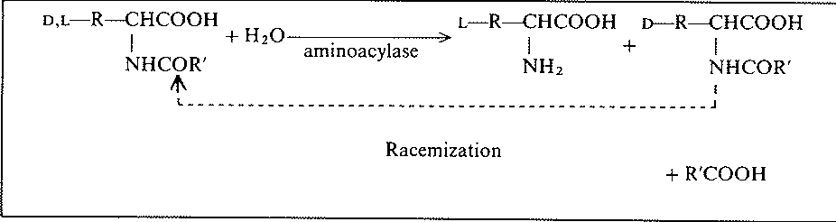
Synthesis of L-aminoacids by aminoacylase
L- amino acids
Acetyl D- amino acids
Acetyl D-and L- amino acids
(Chibata, et al., 1967)

Slide 26
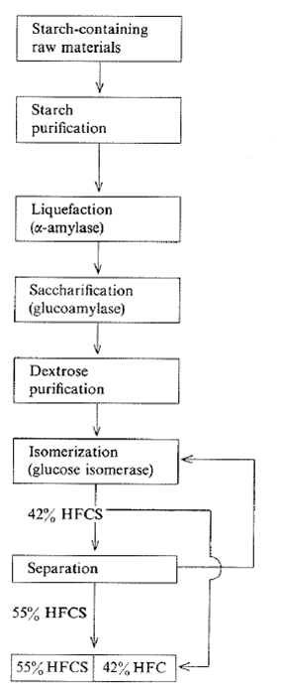
Production of high fructose syrup by glucose isomerase
(Messing and Filbert, 1975)

Slide 27
Clinical applications
Detecting glucose concentration in blood by glucose oxidase and peroxidase.
Removal of urea from blood during haemodialysis by urease.
ELISA technique for HIV test and pregnancy test.

Slide 28
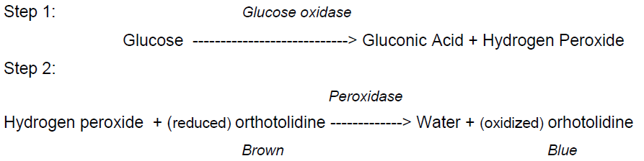
Detecting glucose concentration in blood by glucose oxidase and peroxidase:
(Klang, et al., 1976)

Slide 29
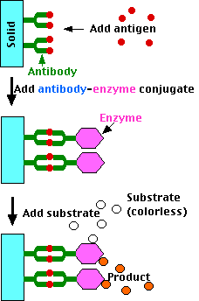
Principle of ELISA for diagnosis

Slide 30
Other Applications
Production of semi-synthetic antibiotics like ampicillin by Penicillin G acylase.
Catalase is used for determination of heavy metals(Hg) and pesticides on basis of enzyme inhibition principle.
Glutathion S transferase is used to determine capton in water.
Bacterial proteases used in leather industries.

Slide 31
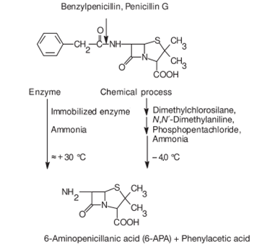
Comparison of chemical and enzymatic process for hydrolysis of Pencillin G
(Mosbach, 1976)

Slide 32
Future Prospects
Although the best method of immobilization might differ from enzyme to enzyme, from application to application and from carrier to carrier, but the criteria for assessing the robustness of enzymes remain the same.
So the focus should be the development of a new method that combines the advantages of carrier-bound and carrier-free methods which provide high enzyme loading, high retention of activity and broad reactor configurations.

Slide 33
Conclusion
Immobilization technology will continue to create exciting new opportunities for commercial development / profits in a wide range of industrial sectors including healthcare and medicine, food technology, agriculture etc.
Thus, immobilization technology offers a great deal of hope for solving many of the problems our world facesǃ

Slide 34
THANK YOU

